Slide 1

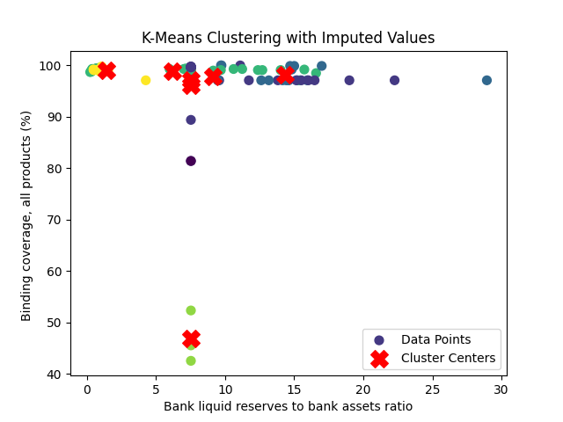
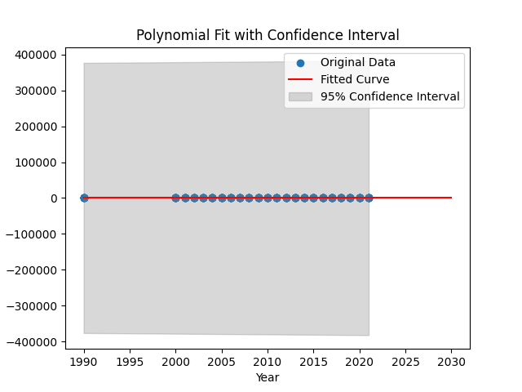
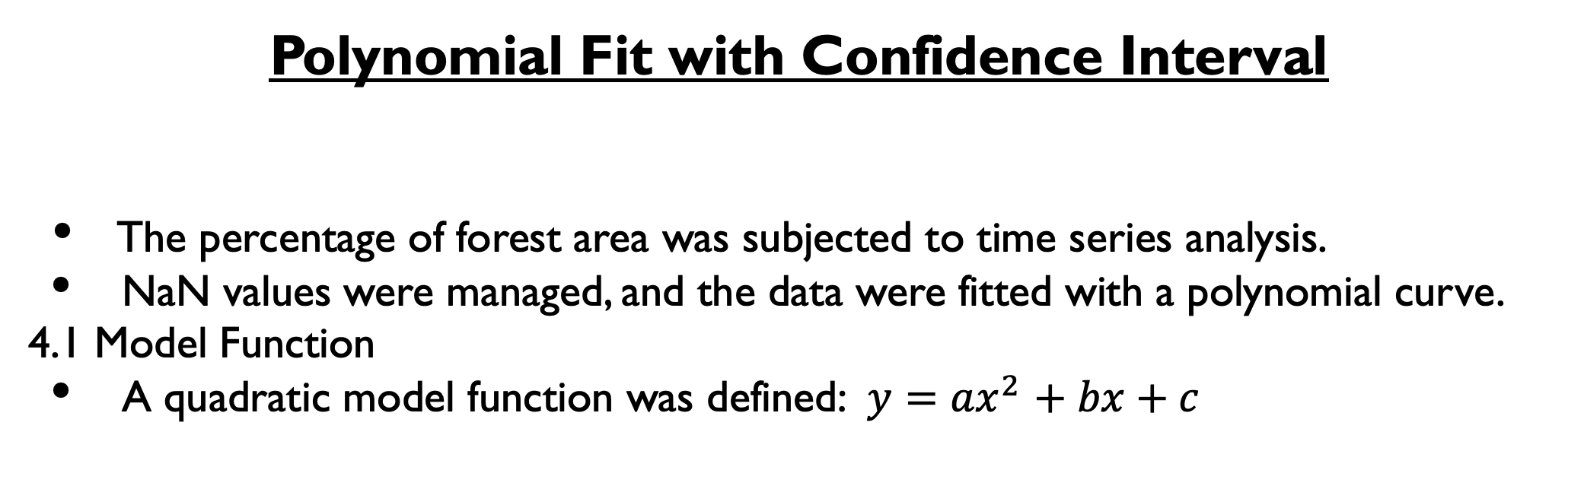
Name: Sanghavi Rangineni
Student Id: 22086311
K-Means Clustering
The pre-processed data was run through the seven clusters of the K-Means algorithm.
A cluster quality statistic known as the Silhouette Score was computed.
Silhouette Score: 0.7234135839410123
Synopsis
This study combines two different approaches, K-Means Clustering and Polynomial Fitting, to investigate patterns and time trends in a heterogeneous dataset that includes environmental and socioeconomic variables.
year | predicted_value_for_forestLand
2018 | 21.18203041
2019 | 21.27129945
2020 | 21.35618044
2021 | 21.43667339
2022 | 21.5127783
2023 | 21.58449517
2024 | 21.651824
2025 | 21.71476479
2026 | 21.77331754
2027 | 21.82748225
2028 | 21.87725892
2029 | 21.92264755
2030 | 21.96364813
2031 | 22.00026068
Overview
This Python software combines two different analytical methods to extract information from a collection of economic and environmental indicators. In order to promote awareness of global trends and inequalities, the first section uses K-Means clustering to find patterns in important socio-economic indicators. A useful method for evaluating environmental sustainability is the second section, which models and predicts changes in forest area over time using polynomial curve fitting.
Polynomial Fit with Confidence Interval
The percentage of forest area was subjected to time series analysis.
NaN values were managed, and the data were fitted with a polynomial curve.
4.1 Model Function
A quadratic model function was defined: $y=$ ${ax}^{2}$ $+ bx+c$
Data Pre-processing
2.1 Handling Missing Values
At first, there are ".." missing values in the dataset. pd.NA was used in their place.
Selected columns relevant for clustering were extracted.
2.2 Imputation
The mean was used to impute missing numerical values in the chosen features.
GitHub:
DataLink: https://databank.worldbank.org/reports.aspx?source=2&series=AG.LND.FRST.ZS&country=

